Slide 1
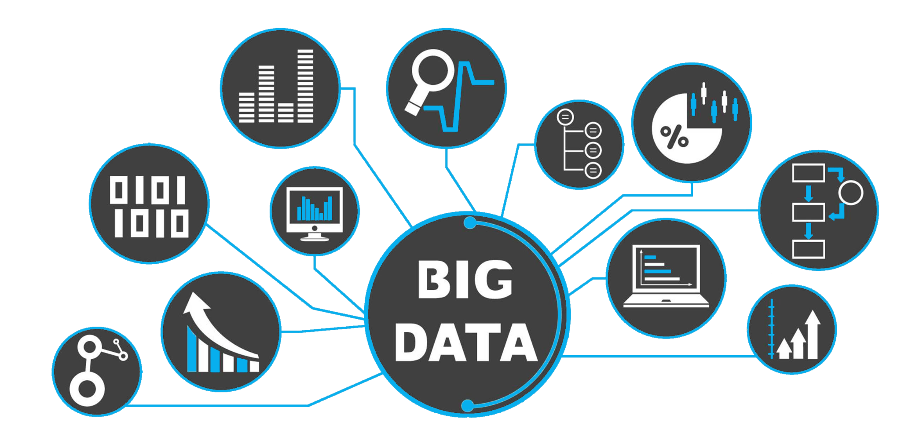
Big Data Case Study
By :
Abdelrahman Ashraf
Ahmed Atef
Hussein Khaled
Omar Ashraf

Slide 2
Table of contents
01
02
03
04
05
06
Introduction
Architecture Overview
Batch Processing Pipeline
Streaming Data Processing
Insights
Automation

Slide 3
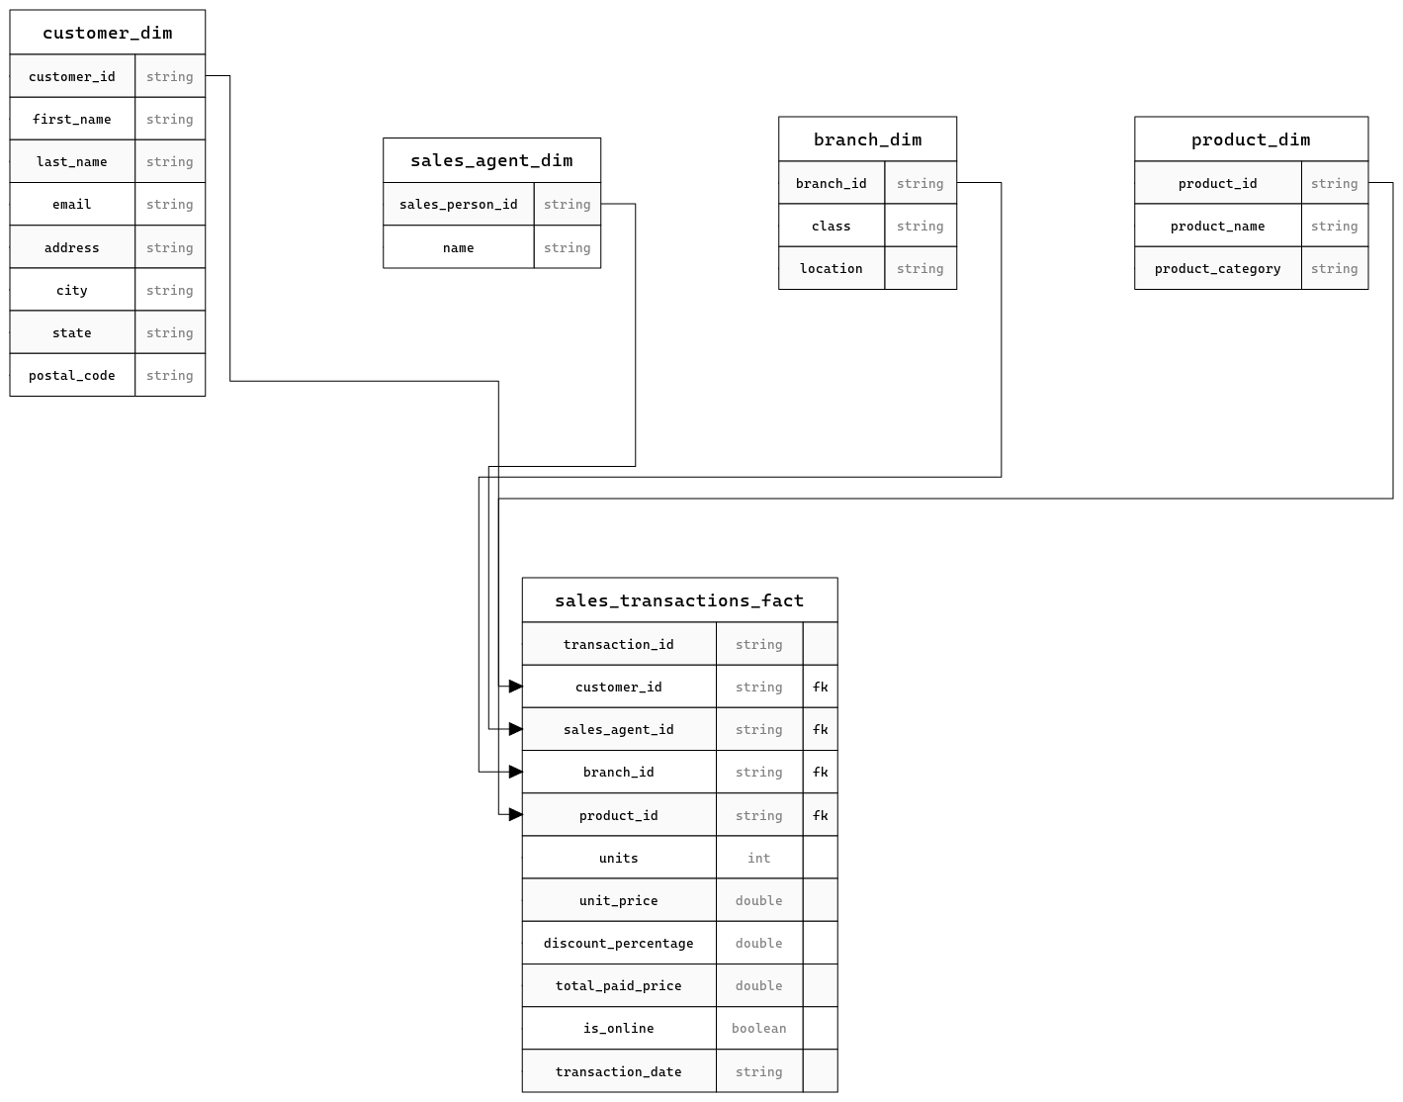

Slide 4
Introduction
Q Company : A leading retailer with physical branches and a thriving e-commerce platform.
Data Challenges:
Disparate data sources (CSV files, Kafka streams).
Hourly updates requiring efficient processing.
Need for timely insights to drive business decisions.
Project Goals:
Streamline data ingestion and transformation.
Create a structured data warehouse for analysis.
Empower marketing and B2B teams with actionable insights.
Process app logs from a Kafka cluster using a Spark streaming job and store the processed data on HDFS.

Slide 5
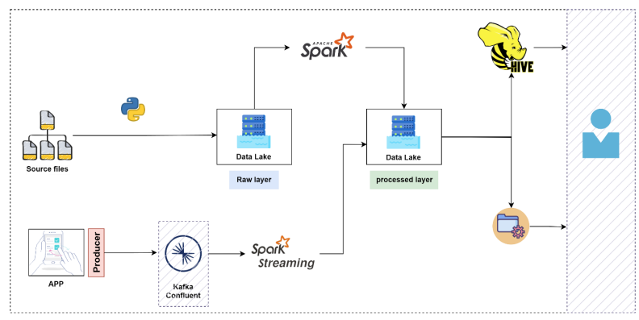
Architecture Overview
Local File System: Raw CSV files are delivered here.
HDFS: Scalable storage for raw and processed data.
Spark: Powerful engine for data transformation and loading.
Hive: Structured data warehouse for analysis and reporting.
Kafka: Streaming platform for handling real-time app logs.
Cron: Scheduler for automating batch processing tasks.

Slide 6
Data Model (Star Schema)
Fact Table: sales_transactions_fact
Captures individual sales transactions (e.g., transaction ID, date, units sold, price, discount).
Dimension Tables:
customer_dim: Customer information (e.g., name, email, location).
product_dim: Product details (e.g., name, category).
sales_agent_dim: Sales agent information (e.g., name, ID).
branch_dim: Branch details (e.g., location, class).

Slide 7

Batch Processing Pipeline
Data Ingestion (ingestCode.py)
Moves files from the local file system to HDFS.
Maintains state to avoid re-processing.
Creates a date-based directory structure in HDFS.
Data Transformation (processing.py)
Reads raw CSV files from HDFS using Spark.
Cleans and transforms data (e.g., handles nulls, calculates metrics).
Loads data into Hive dimension and fact tables.
Implements incremental loading to avoid duplicates.
Daily Sales Report (daily_dump_hive.py)
Generates a CSV report of sales by agent and product.
Executes a Hive query and writes results to the local file system.

Slide 8

Batch Demo

Slide 9
Business Insights (Marketing)
Most Selling Products: Identify top performers to inform inventory and marketing decisions.
Lowest Performing Cities (Online): Target these areas with specific campaigns.
Most Redeemed Offers: Analyze offer effectiveness and customer preferences.
Most Redeemed Offers per Product: Tailor promotions based on product-specific offer uptake.

Slide 10
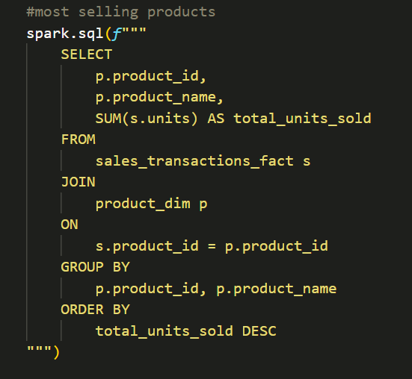
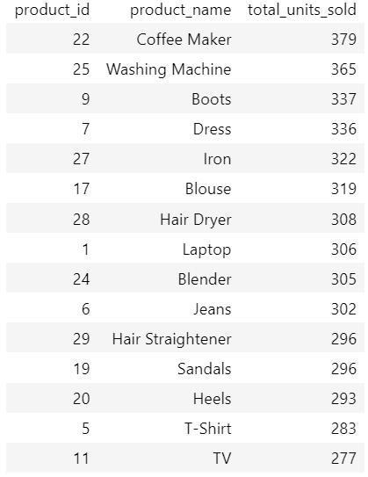
Batch Insights
Most selling products

Slide 11
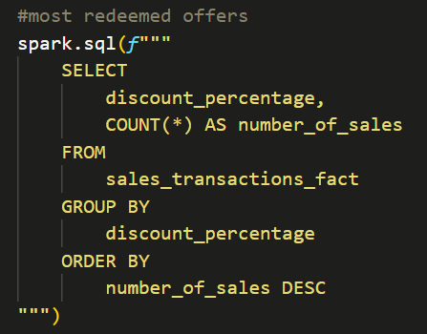
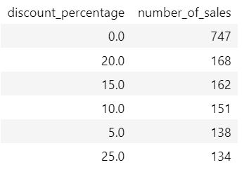
Batch Insights
Most redeemed offers

Slide 12
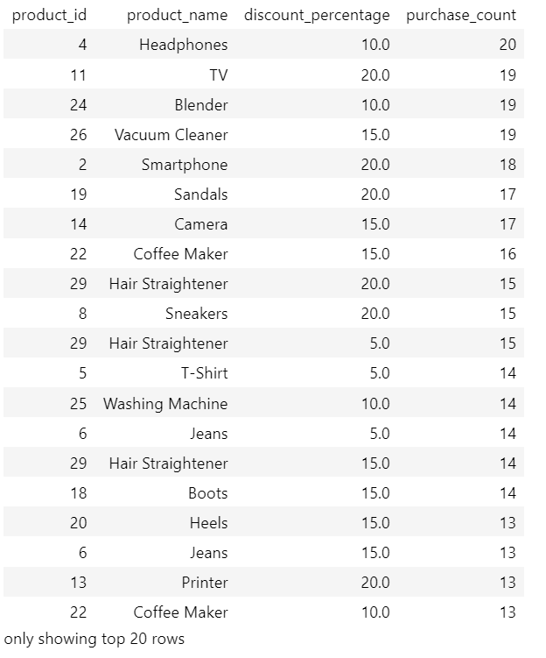
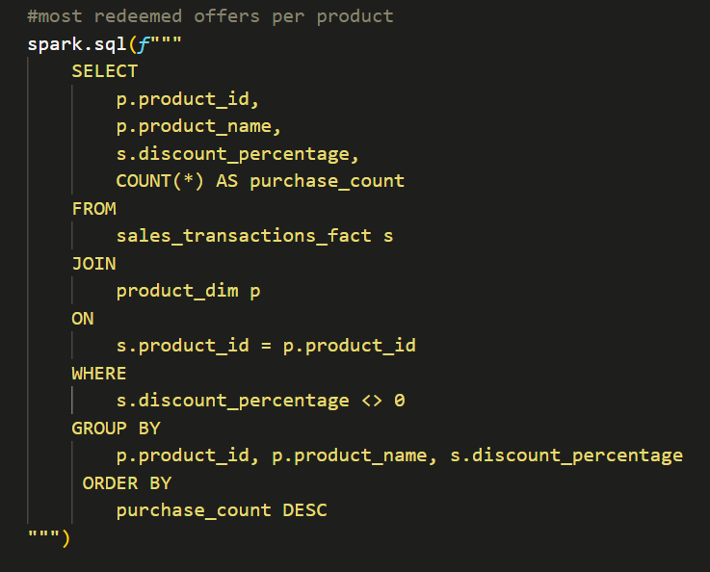
Batch Insights
Most redeemed offers per product

Slide 13
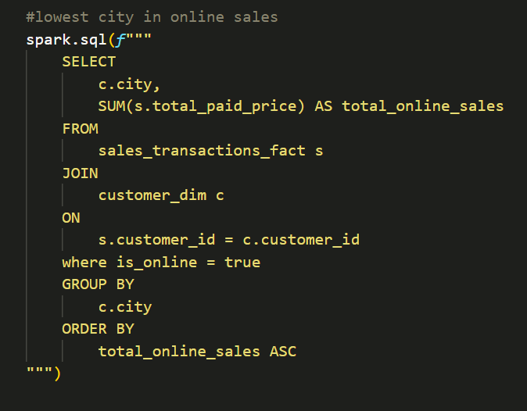
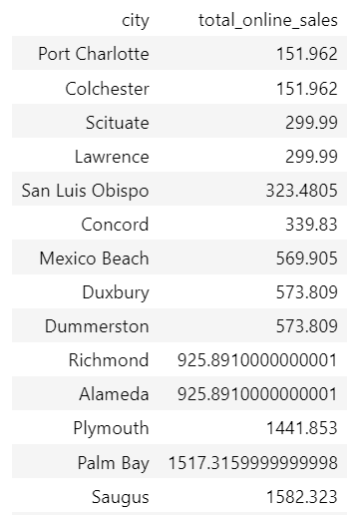
Batch Insights
Lowest performing cities (online sales)

Slide 14
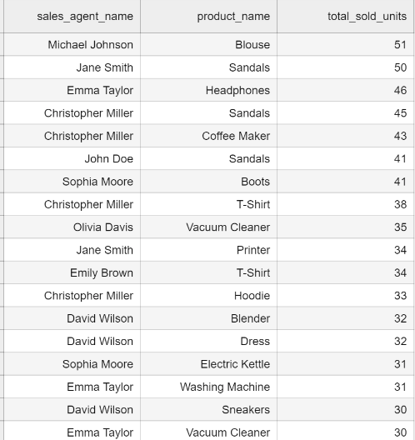
Business Insights (B2B)
Daily Sales Dump: Detailed report of sales by agent and product, enabling performance tracking and targeted sales strategies.

Slide 15

Streaming Data Processing
Kafka Producer (producer.py)
Sends app logs to a Kafka cluster.
Spark Streaming Job (streaming.ipynb)
Consumes app logs from Kafka.
Processes and transforms the log data.
Saves processed data to HDFS, partitioned by date and hour.

Slide 16

Streaming Data Processing
Compaction (compaction.py)
Fix small file problem
Compact the data in just one file
Making Hive See New Partitions (hiveRepairPartition.py)
Fix hive new partitions to be added in metastore
Using command `MSCK REPAIR TABLE table`

Slide 17

Hive Table
CREATE EXTERNAL TABLE IF NOT EXISTS kafka (
eventType STRING, customerId STRING, productId STRING, timestamp STRING,
category STRING, source STRING, quantity INT,
totalAmount DOUBLE,
paymentMethod STRING,
recommendedProductId STRING,
algorithm STRING
)
PARTITIONED BY (event_date STRING, event_hour INT)
STORED AS PARQUET
LOCATION '/user/itversity/casestudy/kafkastream';

Slide 18
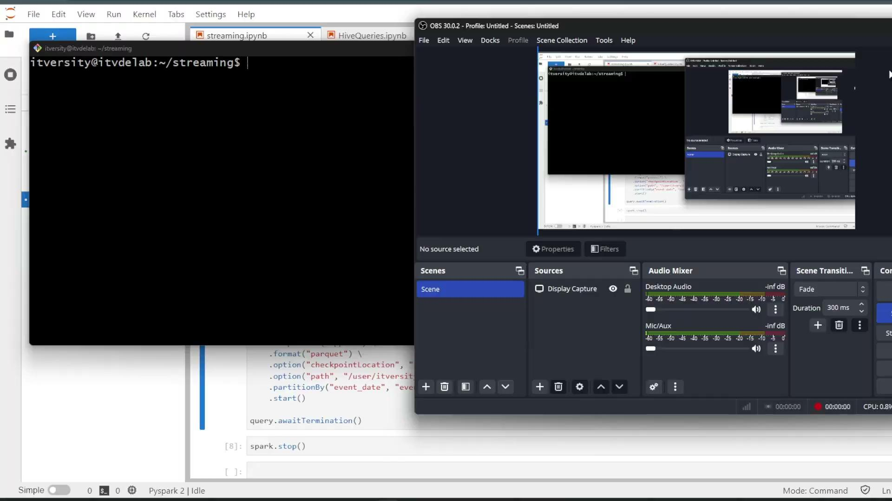
Streaming Demo

Slide 19
Streaming Insights
Total Sales by Payment Method: Understand customer payment preferences.
Most Popular Categories by Events: Identify trending product categories based on app interactions.
Revenue by Customer: Analyze customer spending patterns.
Hourly Sales Analysis: Track sales performance throughout the day.

Slide 20
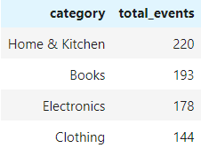
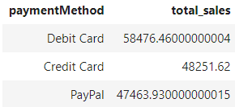
Streaming Insights
Total Sales by Payment Method
Most Popular Categories by Events

Slide 21
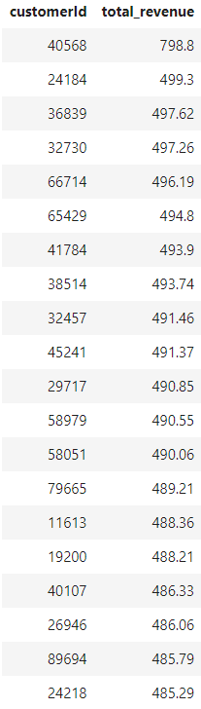
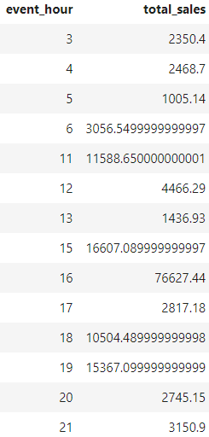
Streaming Insights
Revenue by Customer
Hourly Sales Analysis

Slide 22
Automation and Future Enhancements
Cron: Automates batch processing tasks to ensure timely data updates and reporting.
Future Enhancements:
Schema Evolution: Handle changes in raw data schemas gracefully.
Data Quality: Implement robust data quality checks.
Testing: Develop comprehensive unit and integration tests.
Logging and Monitoring: Enhance logging and monitoring for proactive issue detection.
Parameterization: Make scripts more configurable for flexibility.

Slide 23
Conclusion
Project Success: The data platform successfully integrates and transforms data from multiple sources, providing valuable insights to Q company's marketing and B2B teams.
Business Impact: The platform empowers data-driven decision-making, leading to:
Improved marketing campaigns.
Optimized sales strategies.
Enhanced customer experiences.
Increased revenue and growth.

Slide 24
Thanks!

